Slide 1
Rotary Club of Ann Arbor
Salute to Veterans
November 11, 2020

Slide 2

US Air Force

Slide 3
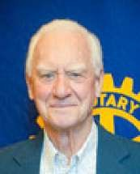
David Anderson
Branch of Service:
U.S. Air Force
Dates of Service:
1955 – 1957
Unit Affiliation:
Flight Surgeon Air Training Command

Slide 4
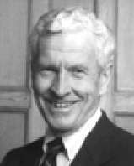
Robert ”Bob” Buchanan
Branch of Service: U.S. Air Force
Dates of Service: 1958 – 1963
Unit Affiliation: 1st Fighter Wing/ 13th Air Force Duty Locations: Clark Air Base
Did You Know?:
Robert Buchanan participated in the Formosan Strait Conflict.

Slide 5
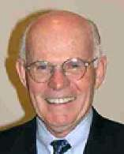
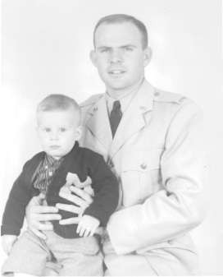
Thomas ”Tom” Conlin
Branch of Service: U.S. Air Force
Dates of Service: 1956 – 1959
Unit Affiliation: Air Defense Command
Duty Locations:
San Antonio, TX Niagara Falls, NY
Desert Rock, 75 miles northeast of Las Vegas
Did You Know?:
Tom observed an atomic blast, part of the Kepler Shot which took place 5:10am on July 22, 1957.

Slide 6
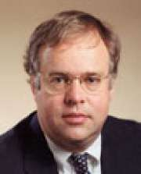
Timothy Johnson
Branch of Service:
U.S. Air Force
Dates of Service:
1981 – 1985
Unit Affiliation:
Medical Corps

Slide 7
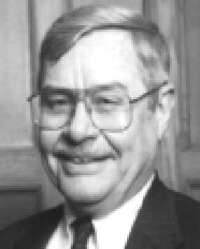
Duane Renken
Branch of Service:
U.S. Air Force
Dates of Service:
1956 – 1958
Unit Affiliation:
Air Force Special Weapons

Slide 8
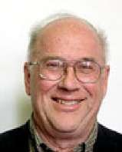
Brooks Sitterley
Branch of Service:
U.S. Air Force
Dates of Service:
1962 – 1964
Unit Affiliation:
Detroit AFES
Armed Forces Examining Station
Location served: Detroit

Slide 9
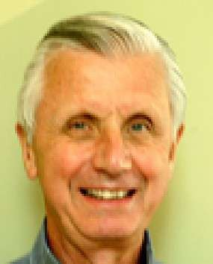
David Schmidt
Branch of Service: U.S. Air Force
Dates of Service: 1960 – 1963
Unit Affiliation:
Weather Recon Squadron Flight Surgeon
Duty Locations:
Thailand
Did You Know?:
David Schmidt served in Thailand as the United States was beginning its involvement in Vietnam. David remembers that there was no shortage of snakes in the Boonies of Thailand.

Slide 10
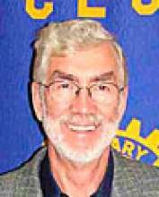
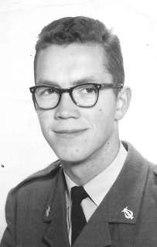
Frode Maaseidvaag
Branch of Service: Royal Norwegian Air Force
Dates of Service: 1957 – 1958
Unit Affiliation: Secure Nato HQ’s Communications
Duty Locations:
Gardemoen Air Base 30 miles north of Oslo, Norway
Did You Know?:
Frode served with 30 U.S. Air Force soldiers at the NATO base in Norway. After immigrating to the U.S., Frode has seen three of these Americans. Each of these meetings were all by chance.

Slide 11
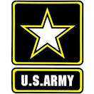
U. S. Army

Slide 12
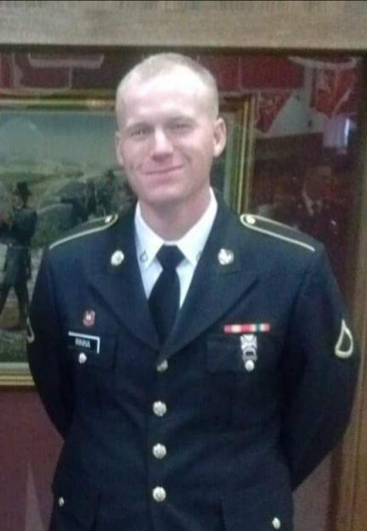
Christian Rinna
Branch of Service: U.S. Army
Dates of Service: 3 years
Affiliation: 12N horizontal construction engineer, 62 Engineer battalion and 4th engineer battalions, Fort Carson
Duty Location: Fort Carson, Colorado; Fort Jackson
South Carolina; Fort Leonard Wood
Missouri, Fort Lewis McCord,
Washington State, Fort Bliss Texas &
West Africa.

Slide 13
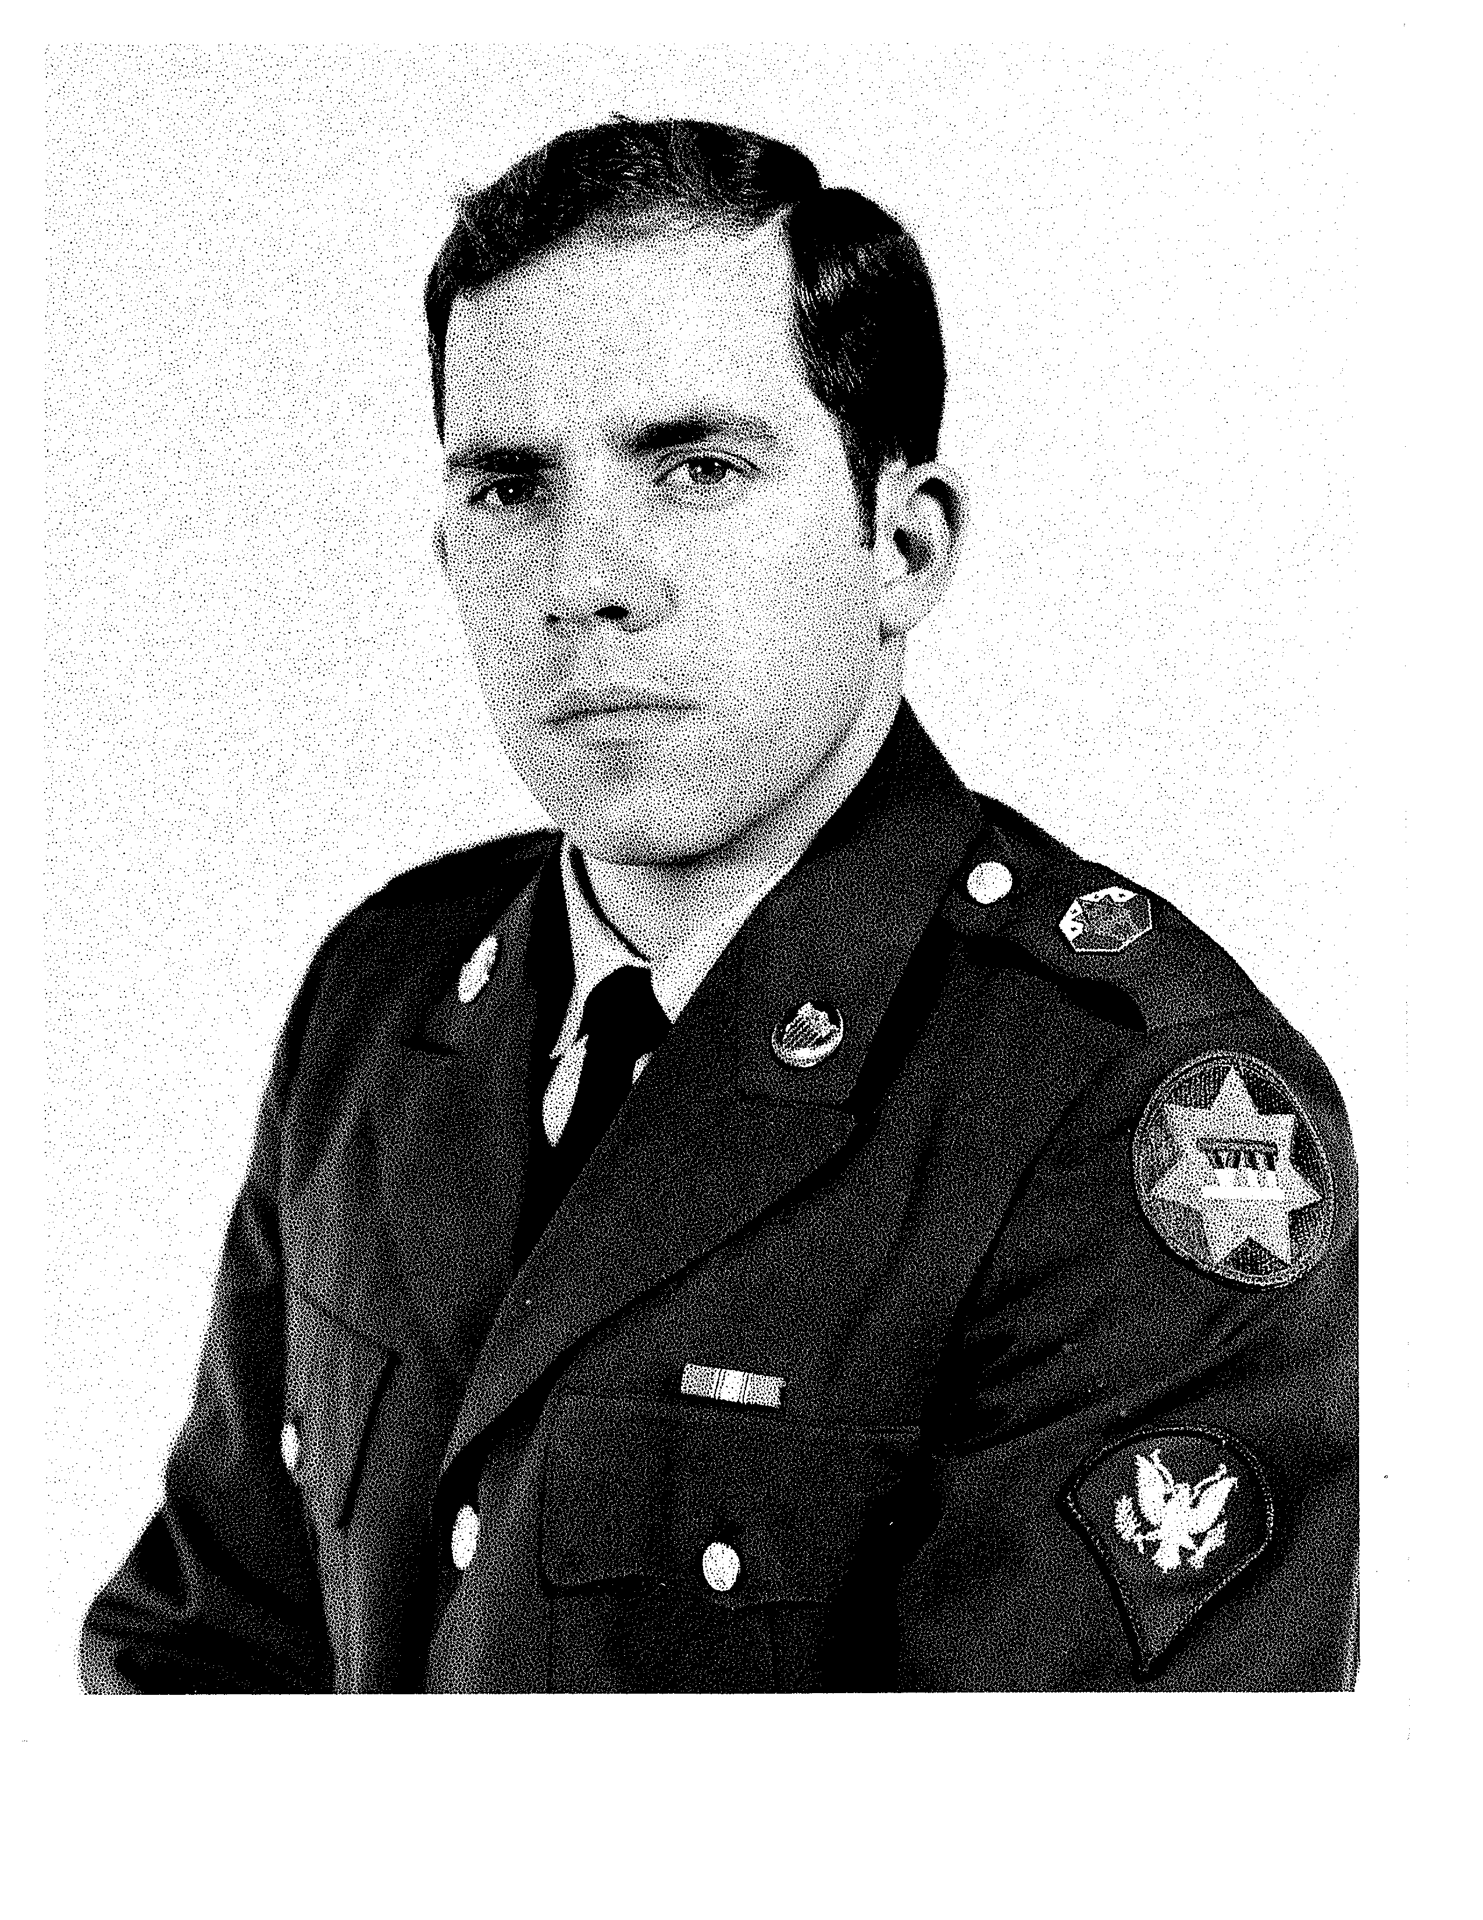
Roger Fraser
Branch of Service:
Dates of Service:
Unit Affiliation:
U.S. Army
1969-1970
Ft. Knox, Ky. and Stuttgart
Duty Locations:
HQ. CO., IIV Corps HQ, Kelly Barracks, Stuttgart-Pleiningen, Germany
Did You Know?:
Roger’s son was born 2 weeks prior to his departure for Germany. With leave time and monthly 3-day passes the family saw much of Europe toting young Ron around in the backseat of a VW Type 3 hatchback.

Slide 14
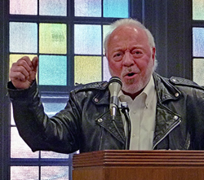
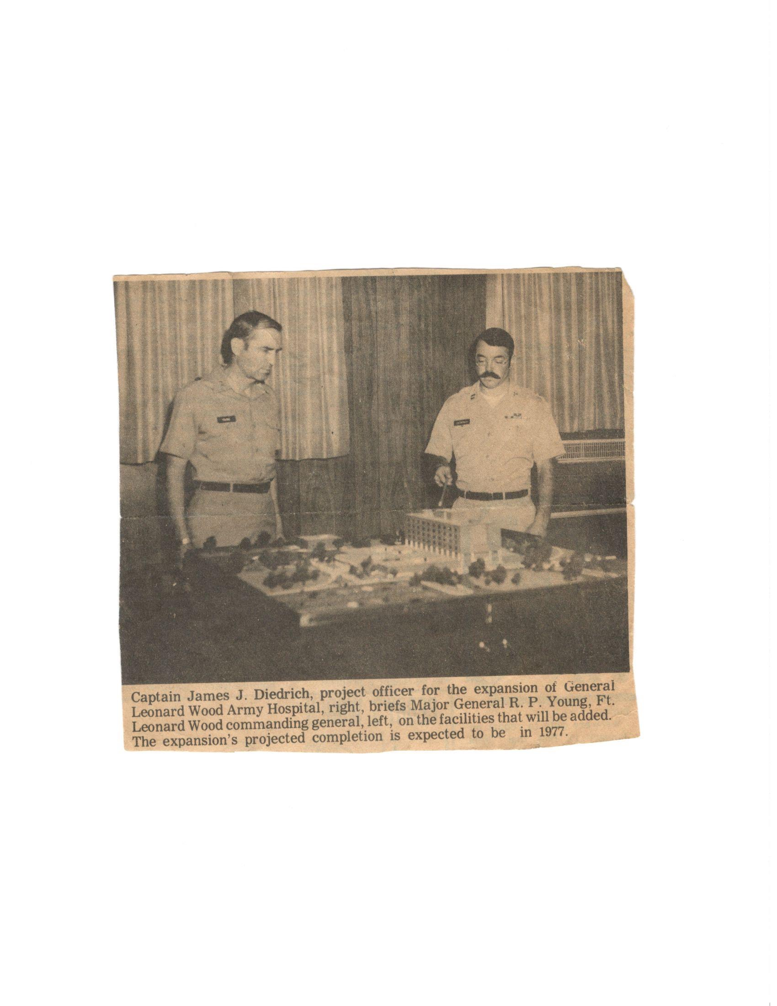
Joe Diederich
Branch of Service:
U.S. Army
Dates of Service:
1969 to 1978
Unit Affiliation:
24th Evacuation Hospital in Long Binh, Vietnam
Did you know:
The 24th Evac. Hosp. was a MASH hospital, much like the movie.

Slide 15
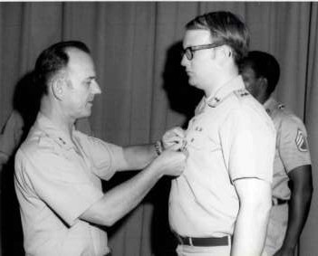
John White
Branch of Service:
U.S. Army
Dates of Service:
1970 – 1972
Unit Affiliation:
Tank Automotive Command, Warren Michigan
Did You Know?:
John White was involved in the “Defense of Van Dyke Ave” against anti-war protestors who were determined to disrupt tank production.

Slide 16
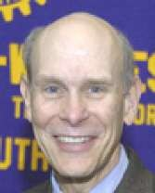
David Keren
Branch of Service:
U.S. Army
Dates of Service:
1976 – 1978
Unit Affiliation:
Walter Reed Army Institute for Research

Slide 17
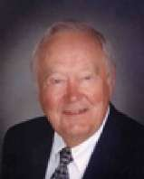
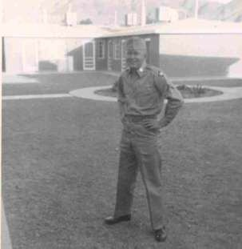
Russ Reister
Branch of Service: U.S. Army
Dates of Service: 1954 – 1956
Unit Affiliation: Nike Missile Training Battalion

Slide 18
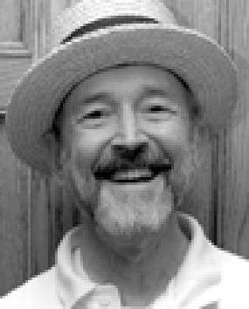
Don Devine
Branch of Service: Army National Guard
Dates of Service: 1957 – 1965
Unit Affiliation: 28th Division 111th Infantry
Duty Location: PA National Guard

Slide 19
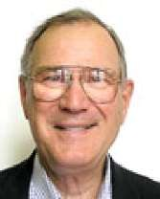
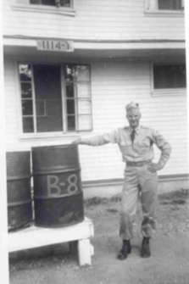
Burton ”Burt” Voss
Branch of Service: U.S. Army
Dates of Service: 1953 – 1955
Unit Affiliation: Chemical Corps Duty Location: Edgewood, MD
Did You Know?:
Burton Voss performed research experiments on the recovery from exposure to nerve gas compounds.

Slide 20
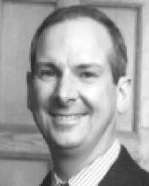
Roland Leeds
Branch of Service: U.S. Army
Dates of Service: 1966 – 1969
Unit Affiliation:
7th Squadron, 1st Air Cavalry 3rd Squadron, 17th Air Cav
Duty Locations:
Dian, Tay Ninh, Chu Chi, and
Saigon Vietnam
Did You Know?:
Roland received the Bronze Star and the Air Medal for Valor for his service in Vietnam. Roland was a Scout Helicopter pilot as well as the Adjutant Chief Admin Officer for a 1000 man unit.

Slide 21
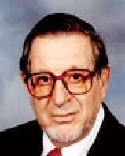
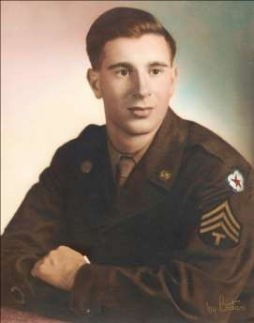
Fred Beutler
Branch of Service: U.S. Army Dates of Service: 1944 – 1946 Unit Affiliation: Signal Corps

Slide 22
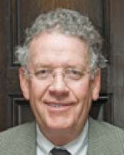
Robert Mull
Branch of Service:
U.S. Army
Dates of Service:
1971 – 1979
Unit Affiliation:
Combat Engineering Corps

Slide 23
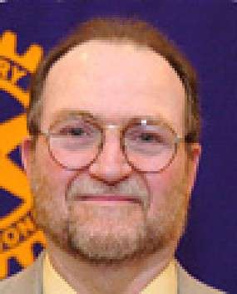
Bob Dascola
Branch of Service: U.S. Army
Dates of Service: 1967 – 1969
Unit Affiliation: 7/8th Field Artillery Battalion Duty Locations: Bien Hoa, Vietnam
Did You Know?:
The Bien Hoa Airbase was attacked in 1968 by the VC as part of the Tet Offensive.

Slide 24
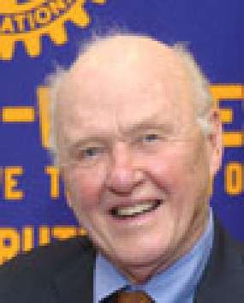
Ray Detter
Branch of Service: U.S. Army
Dates of Service: 1952 – 1954
Unit Affiliation: 101/1st Airborne Division
Duty Locations:
Ray served in the U.S. during
the Korean War.

Slide 25
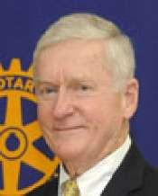
Paul Geiger
Branch of Service:
U.S. Army
Dates of Service:
1955 – 1963
Unit Affiliation:
5th Army HQ’s
Duty Locations:
Chicago, IL
Milwaukee, WI

Slide 26
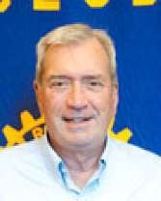
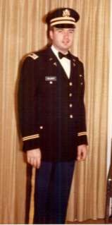
Wayne Colquitt
Branch of Service:
U.S. Army
Dates of Service:
1964 – 1970
Unit Affiliation:
1st Army Dental Corp
Duty Locations:
Aberdeen Proving Grounds, MD
Did You Know?:
Dr. Colquitt served during the Vietnam War.

Slide 27
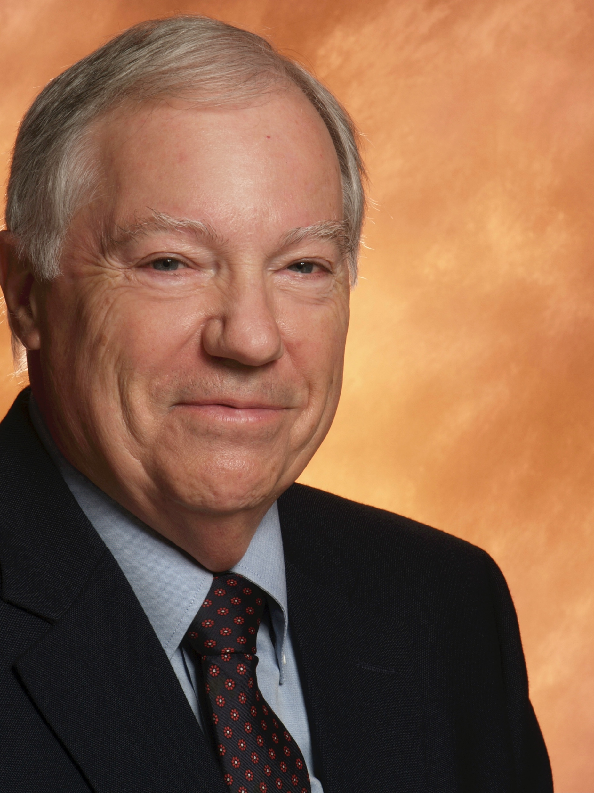
Don Deatrick
Branch of Service:
U.S. Army
Dates of Service:
8 years
Unit Affiliation:
84th Infantry Regiment
Duty location:
In the United States during the Vietnam War
Did you know:
Don was an Advanced Individual Trainer (AIT) instructor. Heavy weapons.

Slide 28
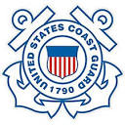
U S Coast Guard

Slide 29
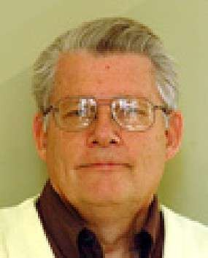
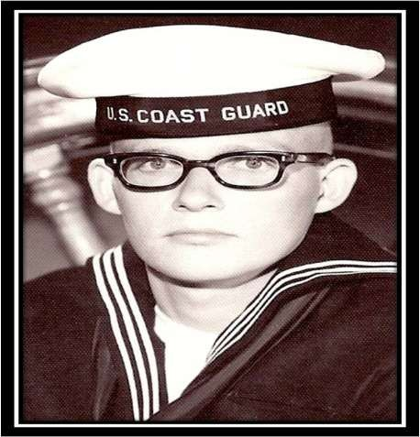
Paul Wright
Branch of Service: U.S. Coast Guard
Dates of Service: 1967 – 1975
Duty Locations:
Cape May, NJ USCGC Unimak and all Coast Guard unts in Michigan.
Did You Know?:
Paul patrolled the waters between Florida and Cuba looking for Cuban refugees and was caught in hurricane Heidi in 1967. From 1972 – 1975, Paul served as Admin Yeoman for all Coast Guard Reserve units in Michigan. instructor USCG Training schools Yorktown, VA. His commanding officer, Thomas Roach would eventually be his Rotary Sponsor.

Slide 30
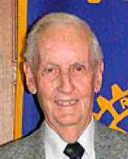
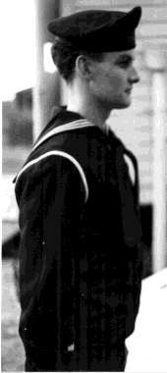
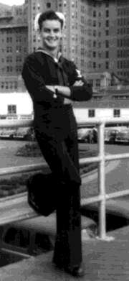
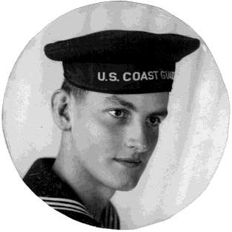
Al Storey
Branch of Service:
U.S. Coast Guard
Dates of Service:
1942 – 1946
Duty Locations:
Michigan Atlantic City, NJ
Did You Know?:
Professor Storey and the
U.S. Coast Guard provided security to stateside ports and docks during WWII.
Instructor: USCG Radio School

Slide 31
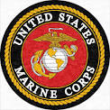
U S Marines

Slide 32
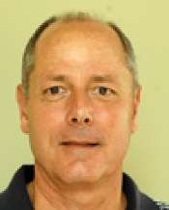
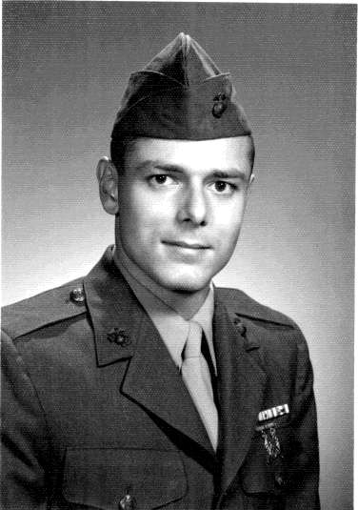
Rob Boehnke Jr.
Branch of Service:
U.S. Marine Corps
Dates of Service:
1966 – 1968
Unit Affiliation:
3rd Battalion / 1st Marine Division
Duty Locations:
Vietnam

Slide 33
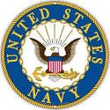
U S Navy

Slide 34
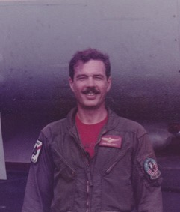
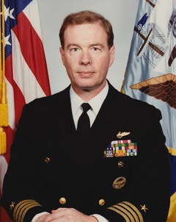
Michael Field
Branch of Service: U.S. Navy
Dates of Service: 1966 - 1994
Unit Affiliation:
Several fighter squadrons and aircraft carriers
Did You Know?:
Michael went to graduate school in Switzerland while on active duty. Retired a Captain
equal to “Bird Colonel”

Slide 35
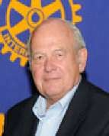
Tony Derezinski
Branch of Service: U.S. Navy
Dates of Service: 1968 – 1971
Unit Affiliation:
Military Judge in Navy Judge Advocate General Corps – Vietnam
Duty Locations:
U.S. Naval Detachment in Nha Be,
Vietnam.
Did You Know?:
Tony served as a Military Judge during the Vietnam War. He presided over court martial proceedings at bases in Danang, Camrhan Ba and Nha Be. Tony received the Navy Commendation Medal with Combat “V” for his actions in the service.

Slide 36
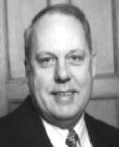
Phil Klintworth
Branch of Service: U.S. Navy
Dates of Service: 1962 – 1991
Unit Affiliation:
Sub Base San Diego
USS Tautog, USS Theo. Roosevelt, USS Sam Houston, USS Snook, USS Permit, USS Remora, Puget Sound Naval Shipyard
Duty Locations:
South China Sea during the Vietnam War

Slide 37
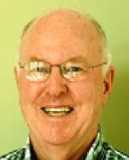
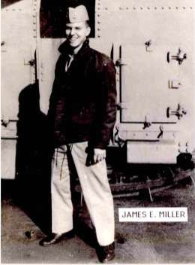
James Miller
Branch of Service: U.S. Navy
Dates of Service: 1961 – 1965
Unit Affiliation: USS Beale, DD-471
Duty Locations:
U.S. Naval Training Center, Great Lakes and North Coast of Cuba
Did You Know?:
While an Officer on the USS Beale, James received a commendation for his involvement in detecting and surfacing the first Russian Submarine which established the Russian’s involvement in the western Atlantic. The incident occurred Oct. 27, 1962.

Slide 38

U S Public Health Service

Slide 39
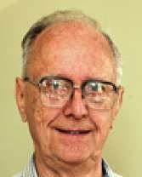
John Atwater
Branch of Service:
U.S. Public Health Service
Dates of Service:
1956 – 1958
Unit Affiliation:
Bureau of State Services Division of General Health Services

Slide 40


Victor Stoeffler
Branch of service: U.S. Public Health Service
Date of service: 1958 to 1966
Location served: Bethesda, Md., Washington D.C. and Staten Island New York

Slide 41
Rotary Club of Ann Arbor
Thanks you for your Service
and your sacrifice

Slide 42
* Compiled by Don Deatrick

